Slide 1
AI Consulting — Final Pitch
Churn prediction
for Ravenstack.
A decision-support tool that tells the customer success team who to call — before the customer cancels.
Markus von Aschoff · AI Consultant · June 2026
01

Slide 2
02 · THE PROBLEM
CEO + OPS
Customers cancel. Nobody sees it coming.
A customer stops logging in. Six weeks later the cancellation email arrives. By then the renewal conversation is already lost. The CS team — just 1 to 3 people for 390 accounts — finds out too late to act.
LOST TO CHURN SO FAR
AT RISK NEXT 12 MONTHS
OF CHURN IN FIRST 90 DAYS
$14.1M
$47.2M
53%
ARR from cancelled accounts, ‘23–’24
At the 4%/month SMB SaaS benchmark
The window where outreach matters most
This is measured from Ravenstack's own data, not an industry estimate. DevTools accounts churn worst — 31%, twice any other segment.
02

Slide 3
03 · THE SOLUTION
CTO
A weekly ranked list of who to call — and why.
Every Monday, score all 390 accounts, flag the top 20 at risk, and post them to Slack — each with a plain-English reason the CS team can act on.
1
2
3
Score
Explain
Deliver
A model ranks every account by churn risk: account age, segment, usage trend, contract type.
Claude turns each score into one sentence a CS manager can read in 5 seconds and act on.
n8n runs the whole flow on a schedule and posts the digest to the team's Slack channel.
Recommendation AI · rule-based, upgrades to ML
Generative AI · one API call per week
Automation · 8 nodes, no code to maintain
The model recommends. The CS team decides. No message ever reaches a customer automatically.
03

Slide 4
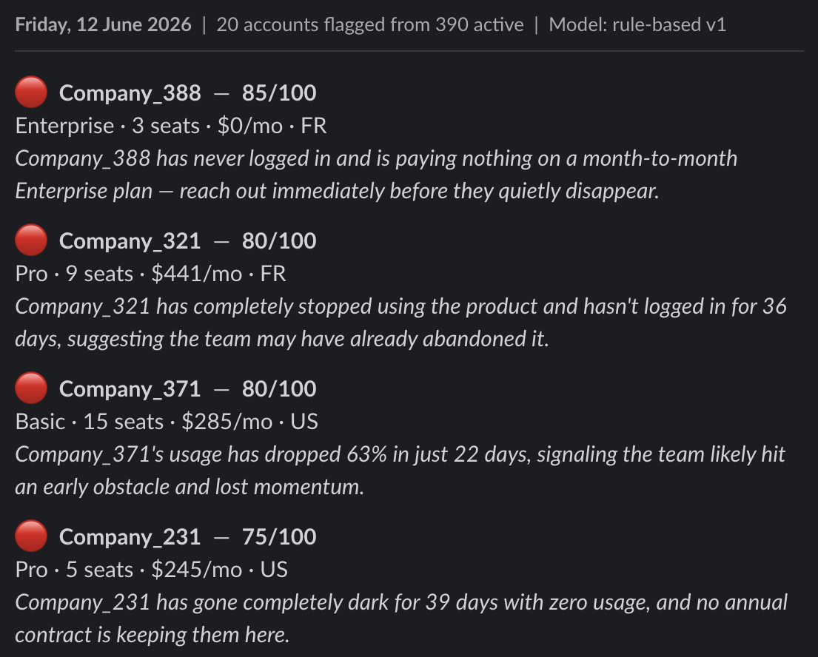
04 · PROOF OF CONCEPT
CTO + OPS
It works today. The digest arrives in under 30 seconds.
How it runs
What the team sees
1
Monday 8 AM — the schedule fires
2
Score all 390 accounts, return top 20
3
Claude writes one reason per account
4
Format and post the digest to Slack
04
Built with n8n, Python, and the Anthropic API. The POC proves the plumbing; the pilot proves the alerts change outcomes.

Slide 5
05 · THE BUSINESS CASE
CEO
Payback in month 5. 199% return in year one.
COST TO BUILD
ARR SAVED / YEAR
RETURN AT 12 MONTHS
$10K
$90K
199%
Upfront, Phases 1–3
If outreach saves 15% of at-risk accounts
366% over 36 months
Horizon
Total cost
Total benefit
Return
12 months
$22,555
$67,500
199%
36 months
$56,035
$261,000
366%
Biggest assumption: a 15% save rate. Honest, and conservative — the pilot measures the real number against a control group.
05

Slide 6
06 · TOP RISKS
LEGAL + CEO
Three risks could derail this. All three are managed.
The model drifts as the product changes
HOW WE MANAGE IT
Retrain monthly. Detect drift weekly — flag any input that shifts more than 20% from its training distribution.
Likelihood 4 × Impact 3 = 12
The CS team stops trusting the alerts
HOW WE MANAGE IT
The team rates alerts from week one. If reaction rates fall below 50% for two weeks, the workflow pauses and we investigate.
Likelihood 3 × Impact 4 = 12
Customer data crosses borders (GDPR)
HOW WE MANAGE IT
Sign the Anthropic and Slack data processing agreements before launch. Send account IDs, not names. No individual personal data in prompts.
Likelihood 2 × Impact 4 = 8
None of these are blockers. Each has a named mitigation and a clear trigger for action. The risks are manageable.
06

Slide 7
07 · COMPLIANCE
LEGAL
Deployable compliantly. Here's why.
EU AI ACT
GDPR
Class: Limited Risk
Basis: legitimate interest
Not in any high-risk Annex III category. The LLM text shown to staff triggers Article 52 transparency duties.
Art. 6(1)(f). Aggregated B2B account data only — no individual personal data in prompts.
Obligation: met
Subject rights: supported
Every digest is labelled 'rule-based v1'. The AI is disclosed from day one.
Access, erasure, rectification, objection. Accounts can be excluded from scoring on request.
Gap to close
Gap to close (blocking)
A short written policy telling the CS team what the model does and does not do.
Sign the Anthropic and Slack data processing agreements before launch.
This system can be deployed compliantly because a human makes every customer-facing decision and the AI is fully disclosed.
07

Slide 8
08 · DEPLOYMENT PLAN
CEO + OPS
POC to full deployment in 14 weeks. Then scale.
Phase 1
Done
Phase 2
Next
Phase 3
Planned
Phase 4
Optional
Weeks 1–3
Weeks 4–10
Weeks 11–14
Month 4+
POC
Pilot
Deploy
Scale
Workflow live on test data
Live alerts to CS team
Swap rules for ML model
Upsell scoring
Slack digest verified
Go/no-go at week 8
CRM + dashboard
Productize decision
Commercialisation:
An internal tool first. $10K upfront, $1,395/month, to protect ~$90K/year. Only if it proves 15%+ lift over 12 months would we consider productizing it as SaaS for other small SaaS firms at $500–$1,500/month.
08

Slide 9
09 · THE ASK
A 60-day pilot to prove the alerts change outcomes.
✓
Worth the investment
✓
Safe to deploy
✓
Won't disrupt the team
$10K to test something that protects $90K a year. Payback in month 5. The downside is capped at the pilot cost.
Limited Risk under the EU AI Act, legitimate interest under GDPR, and a human decides every customer contact.
Five minutes of CS review on a Monday. No new hires. No customer-facing automation. The team owns it.
THE NEXT STEP
Approve a 60-day pilot: score 390 accounts weekly, CS team acts on the top 20, control group holds out, go/no-go at week 8. $10K.
09

